Slide 1
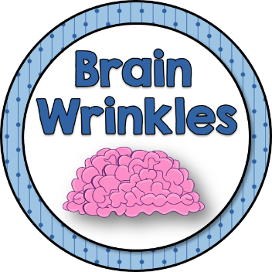
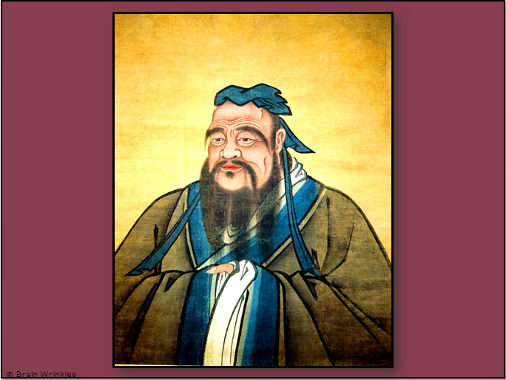
Southern and Eastern Asia’s
BELIEF
SYSTEMS
BELIEF SYSTEMS
Presentation, Graphic Organizers, & Activities

Slide 2
STANDARDS:
SS7G12 Analyze the diverse cultural characteristics of the people who live in Southern and Eastern Asia.
Explain the differences between an ethnic group and a religious group.
Compare and contrast the belief systems originating in Southern and Eastern Asia: Buddhism, Hinduism, Shintoism, and Confucianism.
© Brain Wrinkles

Slide 3
Southern & Eastern Asia’s
Belief
Systems
Buddhism, Hinduism, Shintoism, and Confucianism
© Brain Wrinkles

Slide 4
Ethnic Group
This is a group of people who share common cultural characteristics.
They are identified on the basis of religion, race, or national origin.
Ethnic groups can have many things in common:
Shared history, physical appearance, language, religion, traditions, customs, holidays, food, etc.
© Brain Wrinkles

Slide 5
Ethnic Group
These characteristics have been part of their community for generations.
All of these things make up a common culture that is shared by the members of the ethnic group.
Southern and Eastern Asia’s population is a unique blend of many ethnic groups.
© Brain Wrinkles

Slide 6
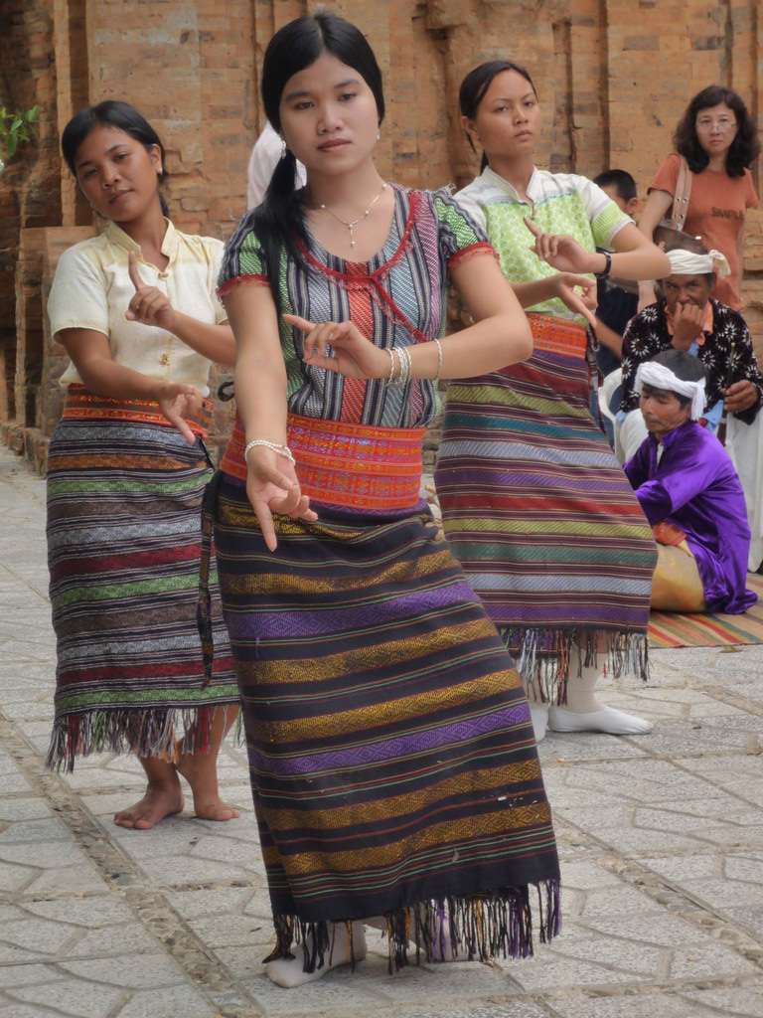
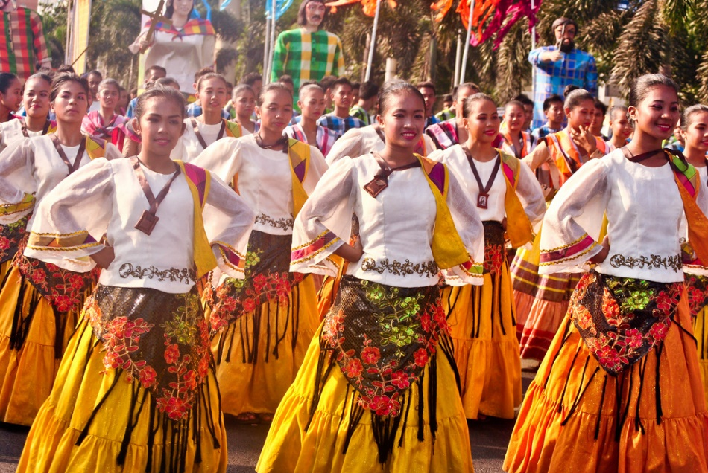
Tagalogs of the Philippines
Chams of Vietnam
© Brain Wrinkles

Slide 7
Religious Group
This is a group of people who share a common belief system.
A religious group is identified based on mutual religious beliefs and practices.
They believe in the same god (or gods) and have a common sacred text with a specific set of rules about how to live.
© Brain Wrinkles

Slide 8
Religious Group
People from different ethnic groups may share the same religion; however, they may be from different cultures.
There are many religious groups found throughout Southern and Eastern Asia, with the most predominate being Buddhism and Hinduism.
There are also followers of the religious philosophies of Shintoism and Confucianism.
© Brain Wrinkles

Slide 9
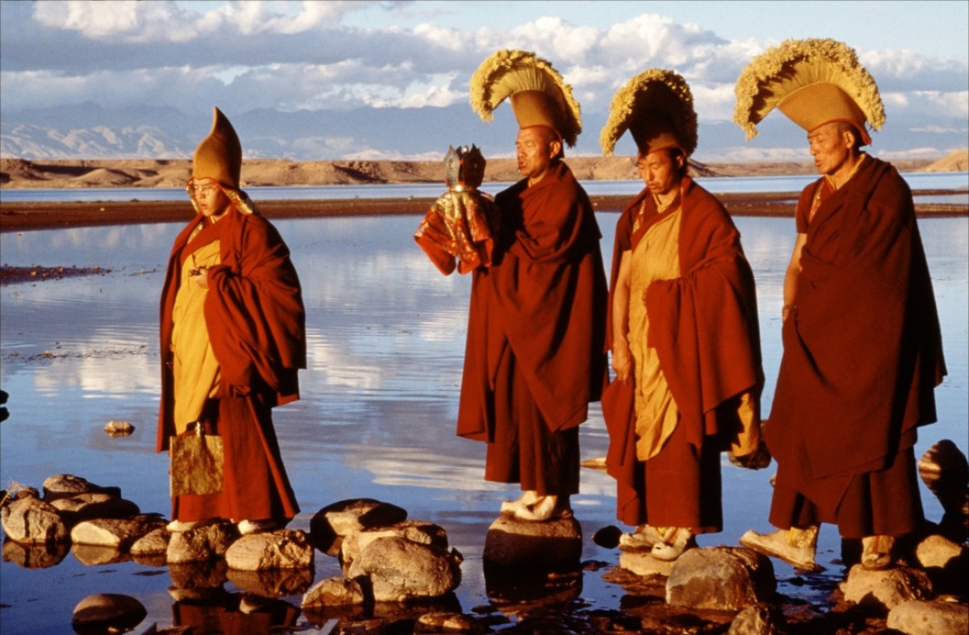
Tibetan Buddhist Monks
© Brain Wrinkles

Slide 10
Buddhism
© Brain Wrinkles

Slide 11
Origin
Around 500 BCE, Buddhism originated in India and rapidly spread from there.
Today, Buddhism is the fourth largest religion in the world with 6% of the population being Buddhist.
The religion’s largest numbers of followers are found in Southern and Eastern Asia.
© Brain Wrinkles

Slide 12
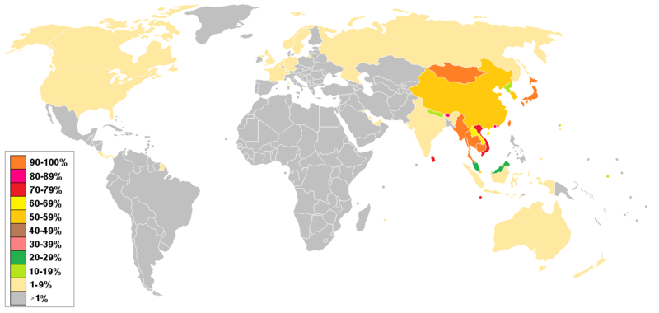
Distribution of Buddhists Around the World
© Brain Wrinkles

Slide 13
Guatama
Buddhism was founded by the royal Indian prince Siddhartha Gautama.
Guatama was a rich man who led a life of luxury; however, he was troubled by the poverty and suffering that he saw around him.
He became a monk and traveled around India for years, hoping to find out why people had to suffer.
© Brain Wrinkles

Slide 14
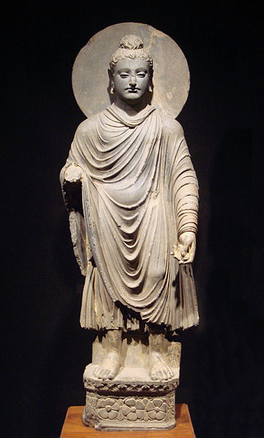
One of the earliest statues of Siddhartha Guatama – circa 1st-2nd century CE.
© Brain Wrinkles

Slide 15
Buddha
After meditating about the unhappiness of man, he finally thought he understood what had to be done.
Guatama felt that people could find peace only if they could reject greed and desire.
He became the Buddha, or “enlightened one”, after spending so much time pondering the ways of life.
© Brain Wrinkles

Slide 16
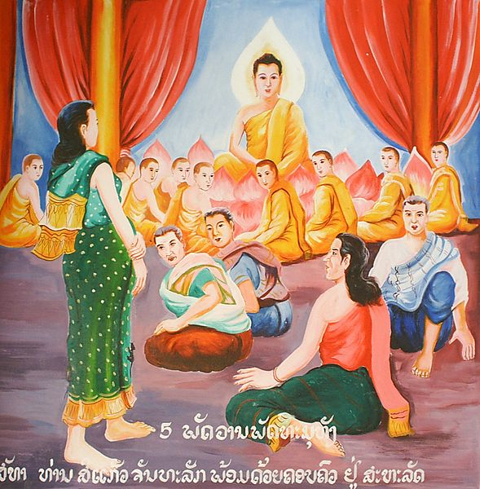
Painting of Buddha Surrounded By Monks
© Brain Wrinkles

Slide 17
Enlightenment
Buddha traveled all over ancient India sharing his enlightenment with others.
Soon, many people became devout followers.
Buddha recorded his basic teachings in the Tripitaka, the holy book that teaches that suffering exists in the world but humans can overcome it by becoming enlightened.
© Brain Wrinkles

Slide 18
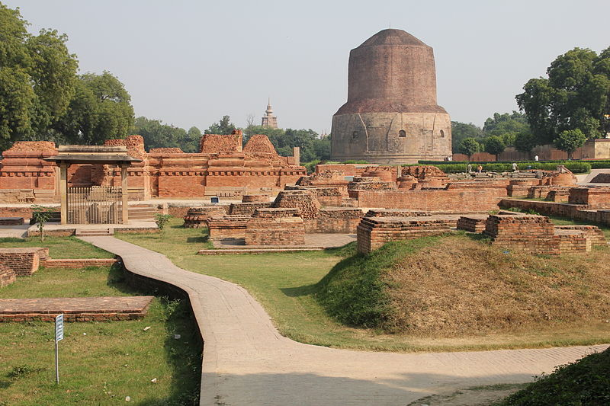
Sarnath – where Buddha gave his first sermon.
© Brain Wrinkles

Slide 19
Beliefs
Buddha taught that there were Four Noble Truths in life (basic instructions that teach suffering exists in the world and humans much reach enlightenment to rise above it).
Buddhists also believe in reincarnation, a cycle of birth and rebirth, where one’s behavior in this life determines what one becomes in the next life.
Buddhists do not believe in a god or gods; instead, they follow Buddha’s teachings.
© Brain Wrinkles

Slide 20
Buddha Tooth Relic Temple - Singapore
© Brain Wrinkles

Slide 21
Nirvana
Nirvana is the ultimate goal of Buddhists.
It is a state of enlightenment where one can have happiness and peace.
In order to achieve Nirvana, a person must follow The Middle Way (eight rules for conduct).
© Brain Wrinkles

Slide 22
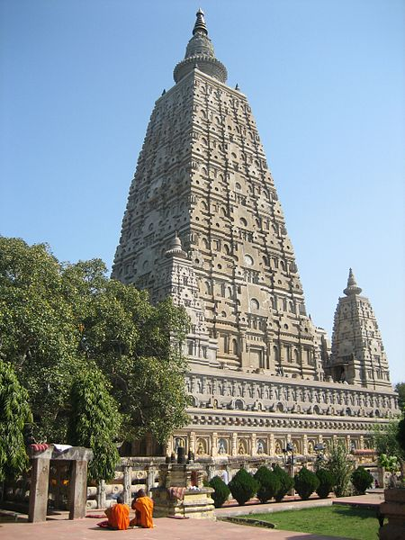
Mahabodhi temple in India - Where Buddha attained nirvana under the Bodhi tree.
© Brain Wrinkles

Slide 23
Middle Way
Try to recognize the truth
Try to avoid evil actions and bad people
Do not say things that hurt others
Respect other people and their belongings
Choose a job that does no harm to others
Do not think evil thoughts
Avoid excitement or anger
Work at meditation, thinking carefully about what matters in life
© Brain Wrinkles

Slide 24
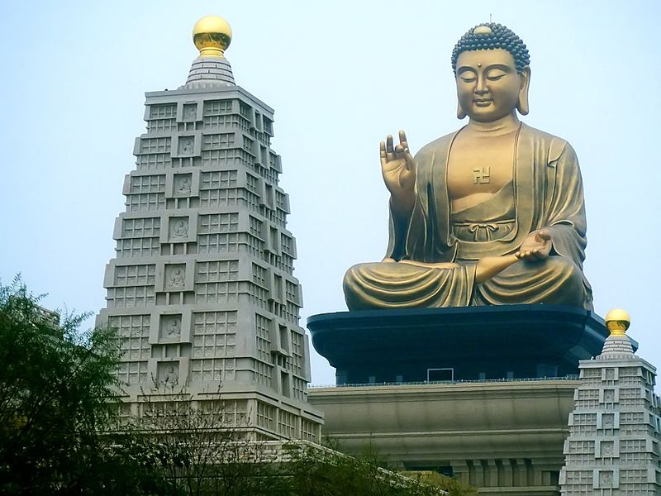
Buddha Memorial Center - Taiwan
© Brain Wrinkles

Slide 25
Hinduism
© Brain Wrinkles

Slide 26
Origin
Hinduism developed in ancient India around 1500 BCE.
Hinduism is the third largest religion in the world, behind Christianity and Islam.
Today, Hinduism is largely practiced in India where over 80% of Indians claim to be Hindu.
© Brain Wrinkles

Slide 27
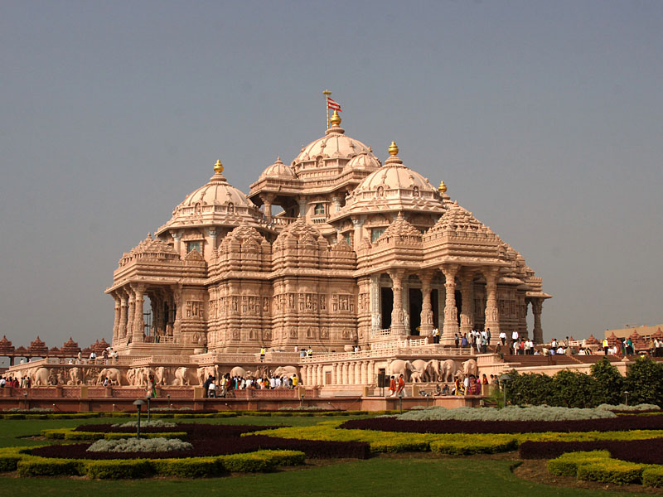
Akshardham Temple in Delhi – World’s Largest Hindu Temple
© Brain Wrinkles

Slide 28
Polytheistic
Hindus are polytheistic, meaning they believe in many gods and goddesses.
There are some gods, like Shiva and Vishnu, who are more significant and are worshipped more often than others.
© Brain Wrinkles

Slide 29
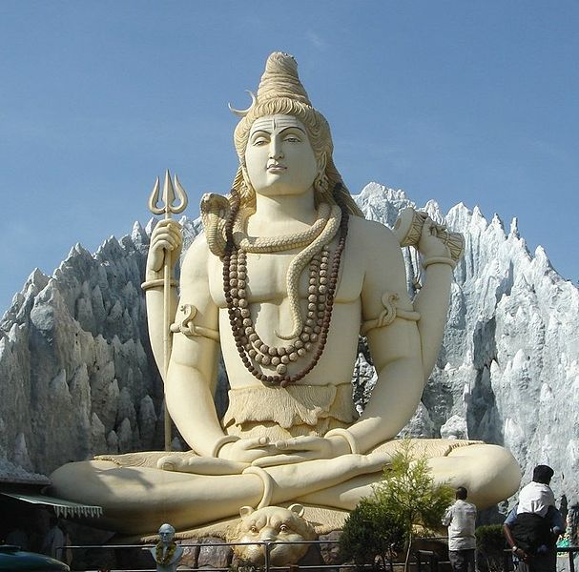
Statue of Shiva – 65 Ft. Tall
© Brain Wrinkles

Slide 30
Texts
Hindus do not have just one holy book that they consider sacred.
Instead, there are many important texts that teach proper Hindu behavior.
The Vedas, which is composed of complicated prayers, rituals, and hymns, is one example.
© Brain Wrinkles

Slide 31
Reincarnation
All Hindus believe in reincarnation, a cycle of birth, death, and rebirth.
They believe that the soul does not die with the body, but enters the body of another being (human or animal) to live another life.
In Hinduism, a person’s karma (good or bad behavior) in one life determines his or her position, wealth, and social class in the next life.
© Brain Wrinkles

Slide 32
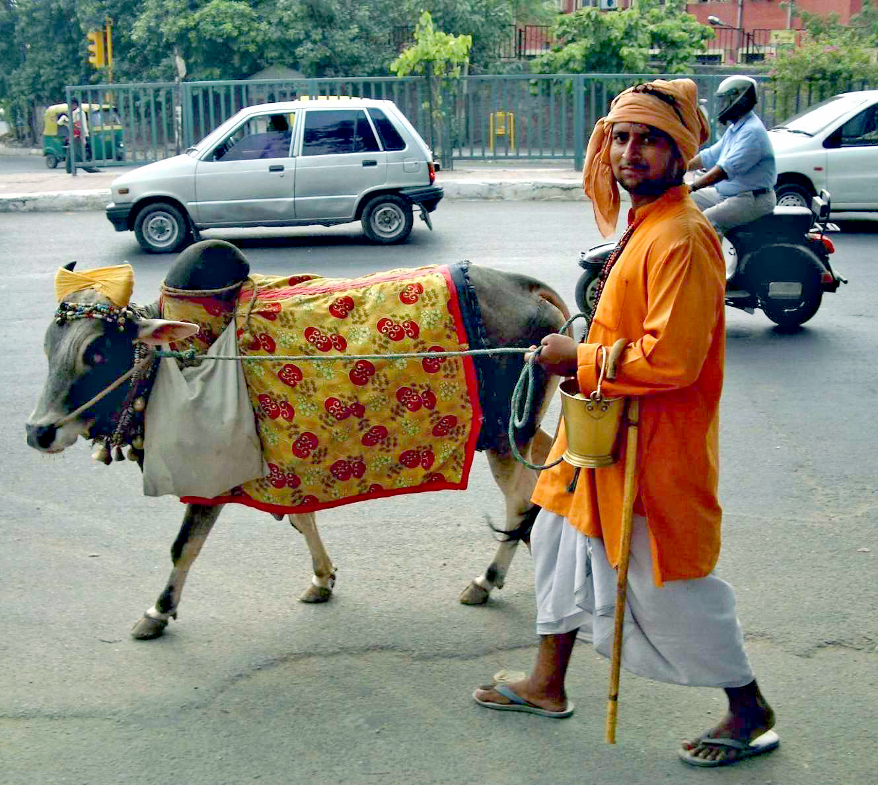
Some animals, like the cow, are especially sacred, and many Hindus are vegetarians.
© Brain Wrinkles

Slide 33
Reincarnation
A soul is reincarnated over and over again until it is good enough to achieve moksha.
The goal of Hindus is to achieve moksha, or peace and freedom from the cycle of reincarnation.
© Brain Wrinkles

Slide 34
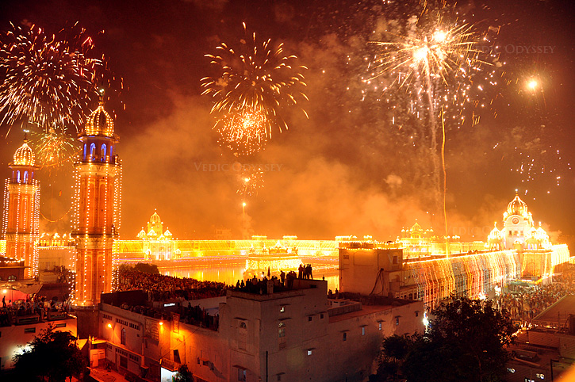
Diwali “Festival of Lights” – Hindu Celebration in India
© Brain Wrinkles

Slide 35
Caste System
Hindus live by the caste system - a belief that social class is hereditary and does not change throughout a person’s life.
Historically, the only way to change castes was to be born into a different one in the next life.
Traditional families would not let their children marry someone from another caste.
Many jobs in India are still awarded based on caste connections.
© Brain Wrinkles

Slide 36
Caste System
The caste system divides people into 4 main classes:
Brahmans (priests and wise men) – highest class
Kashatriyas (warriors, rulers, soldiers)
Vaishyas (merchants, traders, small farmers)
Shudras (peasants and field workers)
A fifth caste is considered even lower, the untouchables or pariahs, who do work that no one else would do.
Today, however, many Hindus can achieve a higher social class through learning new skills or getting an education.
© Brain Wrinkles

Slide 37
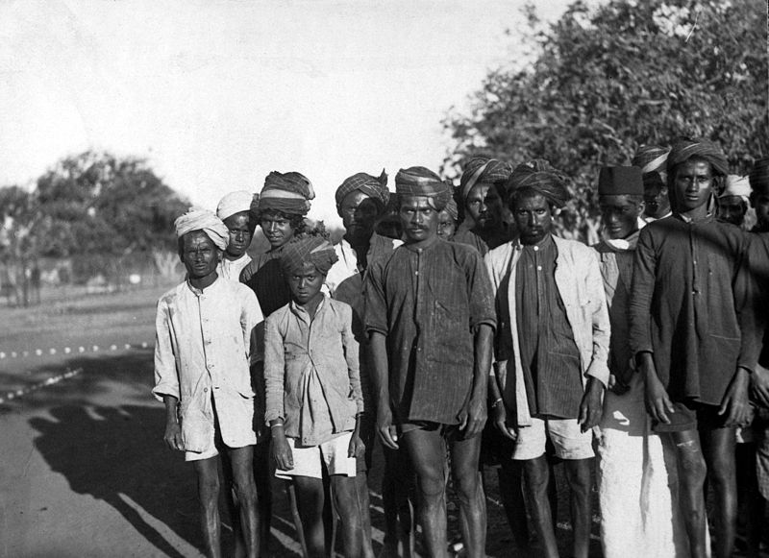
School of Untouchables – Early 1900s
© Brain Wrinkles

Slide 38
The Philosophy of
Shintoism
© Brain Wrinkles

Slide 39
Origin
Shintoism is a belief system that is unique to Japan.
It has not spread to other parts of the world.
Shintoism was once the official state religion of Japan and is still widely honored among the Japanese today.
© Brain Wrinkles

Slide 40
Kami
Shintoism is based on the traditional Japanese teaching that everything in nature contains kami, or the spirit of a god.
Many Japanese believe that the mountains and rivers in Japan are home to these kami and are considered very sacred.
© Brain Wrinkles

Slide 41
Mt. Fuji – Sacred to Shintoism
© Brain Wrinkles

Slide 42
Kami
Shrines are built to help worship ancestors believed to have become kami after death.
Shintoists offer prayers and perform rituals to honor and please the kami.
Most Japanese households have a small altar where the family will offer prayers for the spirits they hope will bless and protect them.
© Brain Wrinkles

Slide 43
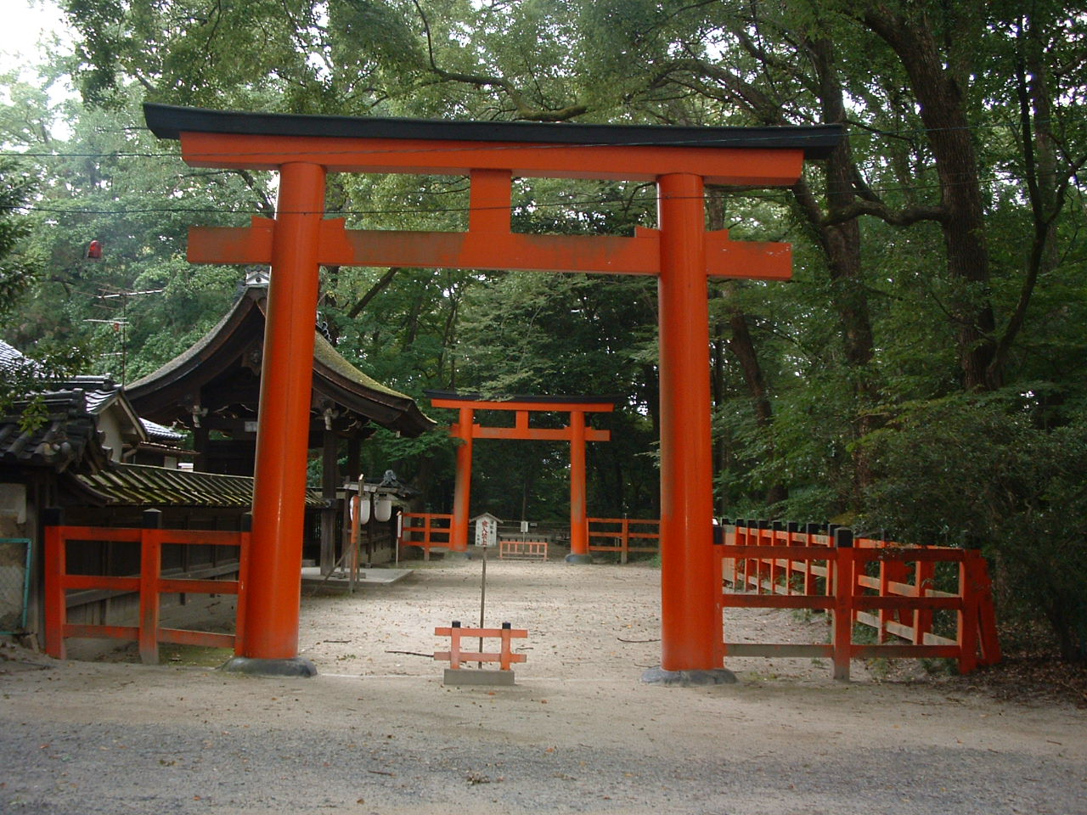
Torri gates mark the separation between the human world and the world of the kami.
Torri Gates Outside of a Shinto Shrine
© Brain Wrinkles

Slide 44
Beliefs
Shintoism follows no single, primary god or text.
Instead, Shintoists follow daily rituals that help connect them to nature and to their ancestors.
Shintoists are expected to respect and honor all life and nature.
© Brain Wrinkles

Slide 45
Beliefs
Shintoism also teaches that physical purity (cleanliness) is more important than moral purity.
Followers must perform many ceremonies and rituals to cleanse and purify the world.
Since Shinto offers no ideas of a moral code, a god, or life after death, many Japanese who practice Shinto also practice another religion as well.
© Brain Wrinkles

Slide 46
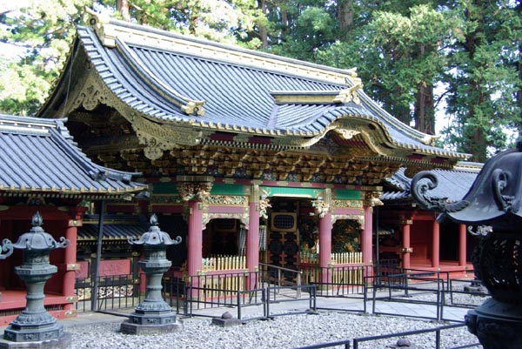
Shinto Shrine
© Brain Wrinkles

Slide 47
The Philosophy of
Confucianism
© Brain Wrinkles

Slide 48
Origin
Confucianism is not a religion but rather a philosophy that is often said to be the foundation of modern Chinese culture.
Confucianism was declared the official guiding practice for the Chinese government in 121 BCE.
It has continued to have great influence on Chinese government for over 2000 years.
© Brain Wrinkles

Slide 49
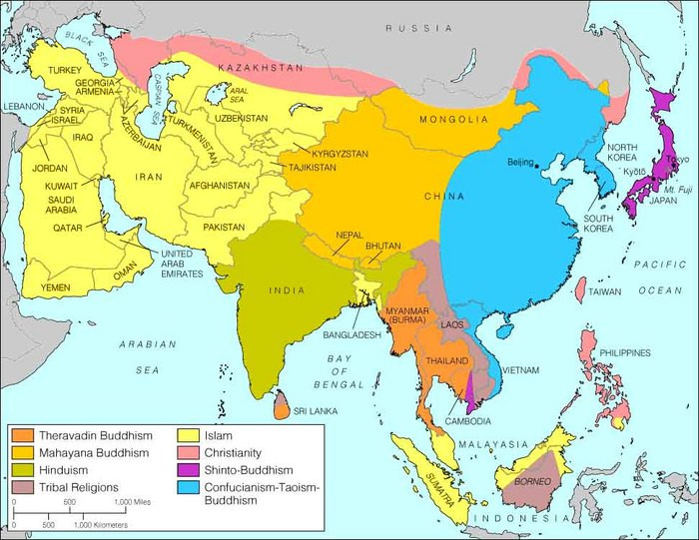
© Brain Wrinkles

Slide 50
Confucius
Confucius was born in 550 BCE, a time when the government was having trouble keeping order and warlords controlled much of the land.
He believed he knew how to bring peace to ancient China – the key was for people to behave with good character and virtue.
Confucius created a moral structure for social life and politics that every person should follow in order to bring peace to China.
© Brain Wrinkles

Slide 51
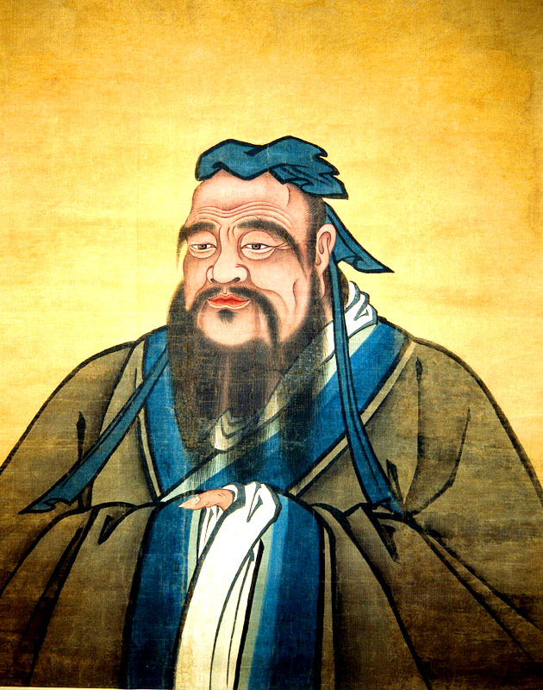
© Brain Wrinkles

Slide 52
Beliefs
Confucianism is based on society and traditions and does not follow one ruling god.
It teaches that each person has a place in society and that he or she must accept that position if society is to function in harmony.
There are five basic types of relationships in society: ruler and subject, father and son, husband and wife, older brother and younger brother, & friend and friend.
© Brain Wrinkles

Slide 53
Golden Rule
Confucius believed that if each relationship were based on kindness, there would be peace and harmony in the country.
His Golden Rule of Behavior was “What you do not like when done unto yourself, do not unto others.”
Confucianism is a belief system based on good deeds and morality.
© Brain Wrinkles

Slide 54
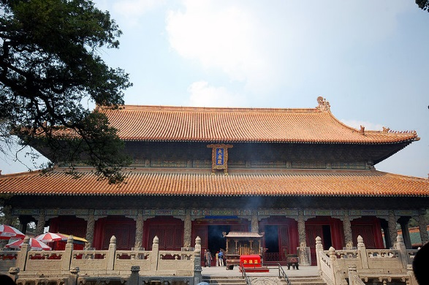
Temple & Cemetery of Confucius in his Hometown
© Brain Wrinkles

